Slide 1
Spanning Tree
Course Code: CSC 2106
Course Title: Data Structure (Theory)
Dept. of Computer Science
Faculty of Science and Technology
Lecture No: | 12.1 | Week No: | 12 | Semester:
Lecturer:

Slide 2
Lecture Outline
Spanning Tree
Minimum Spanning Tree
Prim’s Algorithm
Kruskal’s Algorithm

Slide 3
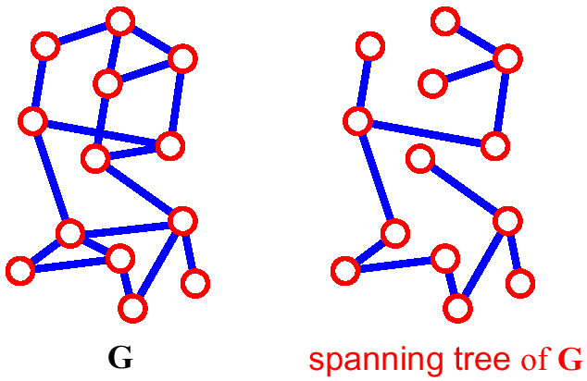
Spanning Tree
A spanning tree of G is a subgraph which is a tree contains all vertices of G
How many edges are there in a spanning tree, if there are V vertices?
(v-1)

Slide 4
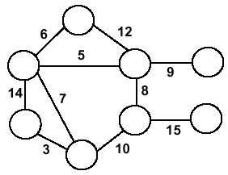
Minimum Spanning Trees (MST)
Undirected, connected graph
G = (V,E)
Weight W

Slide 5
Minimum Spanning Trees (MST)
Undirected, connected graph
G = (V,E)
Weight W
Spanning tree: A spanning tree is a sub-graph of a graph that contains or connects all the vertices and has no cycle.

Slide 6
Minimum Spanning Trees (MST)
Undirected, connected graph
G = (V,E)
Weight W
Minimum spanning tree (MST): Spanning tree where total weight of the tree is minimum.

Slide 7
Applications of Minimum Spanning Tree
Consider n stations are to be linked using a communication network & laying of communication links between any two stations involves a cost. The ideal solution would be to extract a subgraph termed as minimum cost spanning tree.
Suppose you want to construct highways or railroads spanning several cities then we can use the concept of minimum spanning trees.
Designing Local Area Networks.
Laying pipelines connecting offshore drilling sites, refineries and consumer markets.
Suppose you want to apply a set of houses with
Electric Power
Water
Telephone lines
Sewage lines
To reduce cost, you can connect houses with minimum cost spanning trees.

Slide 8
Algorithms for Obtaining the MST
Prim's Algorithm
Kruskal's Algorithm

Slide 9
Prim's Algorithm
Prim’s Algorithm use Greedy approach to find the minimum spanning tree. In Prim’s Algorithm we grow the spanning tree from a starting position.
Vertex based algorithm

Slide 10
Prim's Algorithm
Algorithm Steps:
Maintain two disjoint sets of vertices. One containing vertices that are in the growing spanning tree and other that are not in the growing spanning tree.
Select the cheapest vertex that is connected to the growing spanning tree and is not in the growing spanning tree and add it into the growing spanning tree. This can be done using Priority Queues. Insert the vertices, that are connected to growing spanning tree, into the Priority Queue.
Check for cycles. To do that, mark the nodes which have been already selected and insert only those nodes in the Priority Queue that are not marked.

Slide 11
Prim's Algorithm
T = a spanning tree containing a single node s; E = set of edges adjacent to s; while T does not contain all the nodes {
remove an edge (v, w) of lowest cost from E
if w is already in T then discard edge (v, w)
else {
add edge (v, w) and node w to T
add to E the edges adjacent to w
}
}
An edge of lowest cost can be found with a priority queue
Testing for a cycle is automatic
Hence, Prim’s algorithm is far simpler to implement than Kruskal’s algorithm

Slide 12
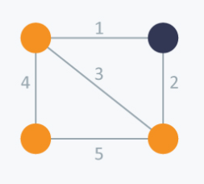
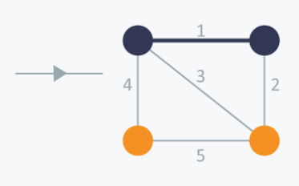
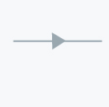
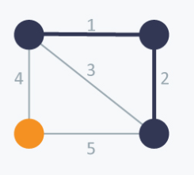
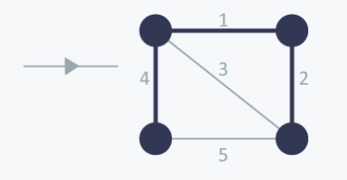
Prim's Algorithm
Consider the example below:

Slide 13
Prim's Algorithm
Explanation:
In Prim’s Algorithm, we will start with an arbitrary node (it doesn’t matter which one) and mark it.
In each iteration we will mark a new vertex that is adjacent to the one that we have already marked. As a greedy algorithm, Prim’s algorithm will select the cheapest edge and mark the vertex.
So we will simply choose the edge with weight 1. In the next iteration we have three options, edges with weight 2, 3 and 4. So, we will select the edge with weight 2 and mark the vertex. Now again we have three options, edges with weight 3, 4 and 5. But we can’t choose edge with weight 3 as it is creating a cycle.
So we will select the edge with weight 4 and we end up with the minimum spanning tree of total cost 7 ( = 1 + 2 +4).

Slide 14
Kruskal's Algorithm
Edge based algorithm
Add edges one at a time in increasing weight order.
Kruskal’s Algorithm builds the spanning tree by adding edges one by one into a growing spanning tree. Kruskal's algorithm follows greedy approach as in each iteration it finds an edge which has least weight and add it to the growing spanning tree.

Slide 15
Kruskal’s algorithm
Algorithm Steps:
Sort the graph edges with respect to their weights.
Start adding edges to the MST from the edge with the smallest weight until the edge of the largest weight.
Only add edges which doesn't form a cycle , edges which connect only disconnected components.

Slide 16
Kruskal’s algorithm
T = empty spanning tree; E = set of edges; N = number of nodes in graph;
while T has fewer than N - 1 edges {
remove an edge (v, w) of lowest cost from E
if adding (v, w) to T would create a cycle
then discard (v, w)
else add (v, w) to T
}
Finding an edge of lowest cost can be done just by sorting the edges
Efficient testing for a cycle requires a fairly complex algorithm (UNION-FIND) which we don’t cover in this course

Slide 17
Kruskal’s algorithm
Consider an undirected, weight graph
F
3
C
10
A
4
3
8
4
5
B
6
D
4
4
H
2
1
3
G
E
3

Slide 18
Kruskal’s algorithm
Sort the edges by increasing edge weight
F
3
C
edge | d_{v}
(D,E) | 1
(D,G) | 2
(E,G) | 3
(C,D) | 3
(G,H) | 3
(C,F) | 3
(B,C) | 4
edge | d_{v}
(B,E) | 4
(B,F) | 4
(B,H) | 4
(A,H) | 5
(D,F) | 6
(A,B) | 8
(A,F) | 10
10
A
4
3
8
4
5
B
6
D
4
4
H
2
1
3
G
E
3

Slide 19
Kruskal’s algorithm
Select first |V|–1 edges which do not generate a cycle
F
3
C
edge | d_{v}
(D,E) | 1 | √
(D,G) | 2
(E,G) | 3
(C,D) | 3
(G,H) | 3
(C,F) | 3
(B,C) | 4
edge | d_{v}
(B,E) | 4
(B,F) | 4
(B,H) | 4
(A,H) | 5
(D,F) | 6
(A,B) | 8
(A,F) | 10
10
A
4
3
8
4
5
B
6
D
4
4
H
2
1
3
G
E
3

Slide 20
Kruskal’s algorithm
Select first |V|–1 edges which do not generate a cycle
F
3
C
edge | d_{v}
(D,E) | 1 | √
(D,G) | 2 | √
(E,G) | 3
(C,D) | 3
(G,H) | 3
(C,F) | 3
(B,C) | 4
edge | d_{v}
(B,E) | 4
(B,F) | 4
(B,H) | 4
(A,H) | 5
(D,F) | 6
(A,B) | 8
(A,F) | 10
10
A
4
3
8
4
5
B
6
D
4
4
H
2
1
3
G
E
3

Slide 21
Kruskal’s algorithm
Select first |V|–1 edges which do not generate a cycle
F
3
C
edge | d_{v}
(D,E) | 1 | √
(D,G) | 2 | √
(E,G) | 3 | χ
(C,D) | 3
(G,H) | 3
(C,F) | 3
(B,C) | 4
edge | d_{v}
(B,E) | 4
(B,F) | 4
(B,H) | 4
(A,H) | 5
(D,F) | 6
(A,B) | 8
(A,F) | 10
10
A
4
3
8
4
5
B
6
D
4
4
H
2
1
3
G
E
3
Accepting edge (E,G) would create a cycle

Slide 22
Kruskal’s algorithm
Select first |V|–1 edges which do not generate a cycle
F
3
C
edge | d_{v}
(D,E) | 1 | √
(D,G) | 2 | √
(E,G) | 3 | χ
(C,D) | 3 | √
(G,H) | 3
(C,F) | 3
(B,C) | 4
edge | d_{v}
(B,E) | 4
(B,F) | 4
(B,H) | 4
(A,H) | 5
(D,F) | 6
(A,B) | 8
(A,F) | 10
10
A
4
3
8
4
5
B
6
D
4
4
H
2
1
3
G
E
3

Slide 23
Kruskal’s algorithm
Select first |V|–1 edges which do not generate a cycle
F
3
C
edge | d_{v}
(D,E) | 1 | √
(D,G) | 2 | √
(E,G) | 3 | χ
(C,D) | 3 | √
(G,H) | 3 | √
(C,F) | 3
(B,C) | 4
edge | d_{v}
(B,E) | 4
(B,F) | 4
(B,H) | 4
(A,H) | 5
(D,F) | 6
(A,B) | 8
(A,F) | 10
10
A
4
3
8
4
5
B
6
D
4
4
H
2
1
3
G
E
3

Slide 24
Kruskal’s algorithm
Select first |V|–1 edges which do not generate a cycle
F
3
C
edge | d_{v}
(D,E) | 1 | √
(D,G) | 2 | √
(E,G) | 3 | χ
(C,D) | 3 | √
(G,H) | 3 | √
(C,F) | 3 | √
(B,C) | 4
edge | d_{v}
(B,E) | 4
(B,F) | 4
(B,H) | 4
(A,H) | 5
(D,F) | 6
(A,B) | 8
(A,F) | 10
10
A
4
3
8
4
5
B
6
D
4
4
H
2
1
3
G
E
3

Slide 25
Kruskal’s algorithm
Select first |V|–1 edges which do not generate a cycle
F
3
C
edge | d_{v}
(D,E) | 1 | √
(D,G) | 2 | √
(E,G) | 3 | χ
(C,D) | 3 | √
(G,H) | 3 | √
(C,F) | 3 | √
(B,C) | 4 | √
edge | d_{v}
(B,E) | 4
(B,F) | 4
(B,H) | 4
(A,H) | 5
(D,F) | 6
(A,B) | 8
(A,F) | 10
10
A
4
3
8
4
5
B
6
D
4
4
H
2
1
3
G
E
3

Slide 26
Kruskal’s algorithm
Select first |V|–1 edges which do not generate a cycle
F
3
C
edge | d_{v}
(D,E) | 1 | √
(D,G) | 2 | √
(E,G) | 3 | χ
(C,D) | 3 | √
(G,H) | 3 | √
(C,F) | 3 | √
(B,C) | 4 | √
edge | d_{v}
(B,E) | 4 | χ
(B,F) | 4
(B,H) | 4
(A,H) | 5
(D,F) | 6
(A,B) | 8
(A,F) | 10
10
A
4
3
8
4
5
B
6
D
4
4
H
2
1
3
G
E
3

Slide 27
Kruskal’s algorithm
Select first |V|–1 edges which do not generate a cycle
F
3
C
edge | d_{v}
(D,E) | 1 | √
(D,G) | 2 | √
(E,G) | 3 | χ
(C,D) | 3 | √
(G,H) | 3 | √
(C,F) | 3 | √
(B,C) | 4 | √
edge | d_{v}
(B,E) | 4 | χ
(B,F) | 4 | χ
(B,H) | 4
(A,H) | 5
(D,F) | 6
(A,B) | 8
(A,F) | 10
10
A
4
3
8
4
5
B
6
D
4
4
H
2
1
3
G
E
3

Slide 28
Kruskal’s algorithm
Select first |V|–1 edges which do not generate a cycle
F
3
C
edge | d_{v}
(D,E) | 1 | √
(D,G) | 2 | √
(E,G) | 3 | χ
(C,D) | 3 | √
(G,H) | 3 | √
(C,F) | 3 | √
(B,C) | 4 | √
edge | d_{v}
(B,E) | 4 | χ
(B,F) | 4 | χ
(B,H) | 4 | χ
(A,H) | 5
(D,F) | 6
(A,B) | 8
(A,F) | 10
10
A
4
3
8
4
5
B
6
D
4
4
H
2
1
3
G
E
3

Slide 29
Kruskal’s algorithm
Select first |V|–1 edges which do not generate a cycle
F
3
C
edge | d_{v}
(D,E) | 1 | √
(D,G) | 2 | √
(E,G) | 3 | χ
(C,D) | 3 | √
(G,H) | 3 | √
(C,F) | 3 | √
(B,C) | 4 | √
edge | d_{v}
(B,E) | 4 | χ
(B,F) | 4 | χ
(B,H) | 4 | χ
(A,H) | 5 | √
(D,F) | 6
(A,B) | 8
(A,F) | 10
10
A
4
3
8
4
5
B
6
D
4
4
H
2
1
3
G
E
3

Slide 30
Kruskal’s algorithm
Select first |V|–1 edges which do not generate a cycle
F
3
C
edge | d_{v}
(D,E) | 1 | √
(D,G) | 2 | √
(E,G) | 3 | χ
(C,D) | 3 | √
(G,H) | 3 | √
(C,F) | 3 | √
(B,C) | 4 | √
edge | d_{v}
(B,E) | 4 | χ
(B,F) | 4 | χ
(B,H) | 4 | χ
(A,H) | 5 | √
(D,F) | 6
(A,B) | 8
(A,F) | 10
A
3
4
5
B
D
H
2
1
}
3
G
E
not
considered
Done
Total Cost = Σ d_{v} = 21

Slide 31
Books
“Schaum's Outline of Data Structures with C++”. By John R. Hubbard (Can be found in university Library)
“Data Structures and Program Design”, Robert L. Kruse, 3rd Edition, 1996.
“Data structures, algorithms and performance”, D. Wood, Addison-Wesley, 1993
“Advanced Data Structures”, Peter Brass, Cambridge University Press, 2008
“Data Structures and Algorithm Analysis”, Edition 3.2 (C++ Version), Clifford A. Shaffer, Virginia Tech, Blacksburg, VA 24061 January 2, 2012
“C++ Data Structures”, Nell Dale and David Teague, Jones and Bartlett Publishers, 2001.
“Data Structures and Algorithms with Object-Oriented Design Patterns in C++”, Bruno R. Preiss,

Slide 32
References
https://en.wikipedia.org/wiki/Data_structure
https://visualgo.net/en/mst?slide=1

